Slide 1
Copilot Readiness
Assessment
Sample Customer
Prepared for Sample Customer / July 25th, 2024

Slide 2
Summary of Findings
Security
Licensing
Optimization
Recommendations
Agenda

Slide 3
Copilot Readiness Summary of Findings
Your environment’s readiness for Copilot has been graded based on data collected from your M365 portal and your Azure portal.
68%
Security: 13 SharePoint sites were found being accessed by 25 groups
Licensing: 0 Users are already licensed for Copilot
Optimization: 35 Users aren't using the complete Office suite
The following slides outline how to increase readiness in all three areas.
23%
45%

Slide 4
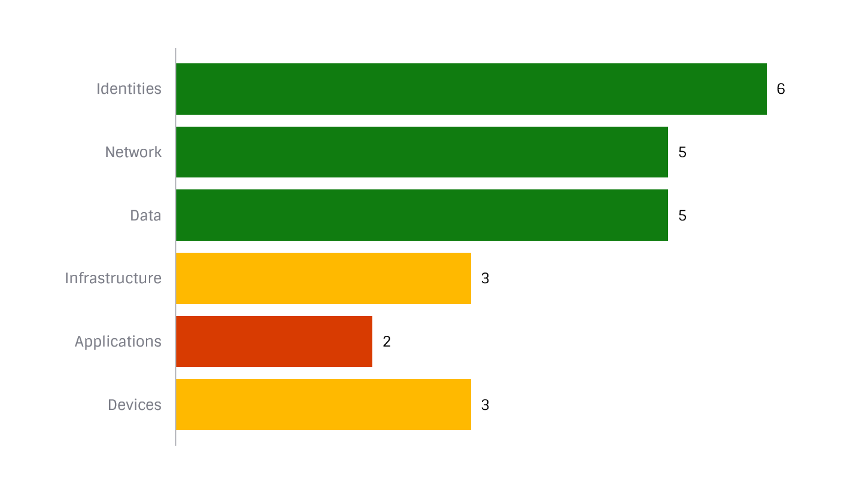
Security
Zero Trust Scores
Your Current Zero Trust Score is 24 of out 36 possible points
Based on your survey responses, additional measures should be taken in 3 of the 6 Zero Trust domains.
Making sure your environment is secured is the first step to ensuring you are Copilot ready.

Slide 5
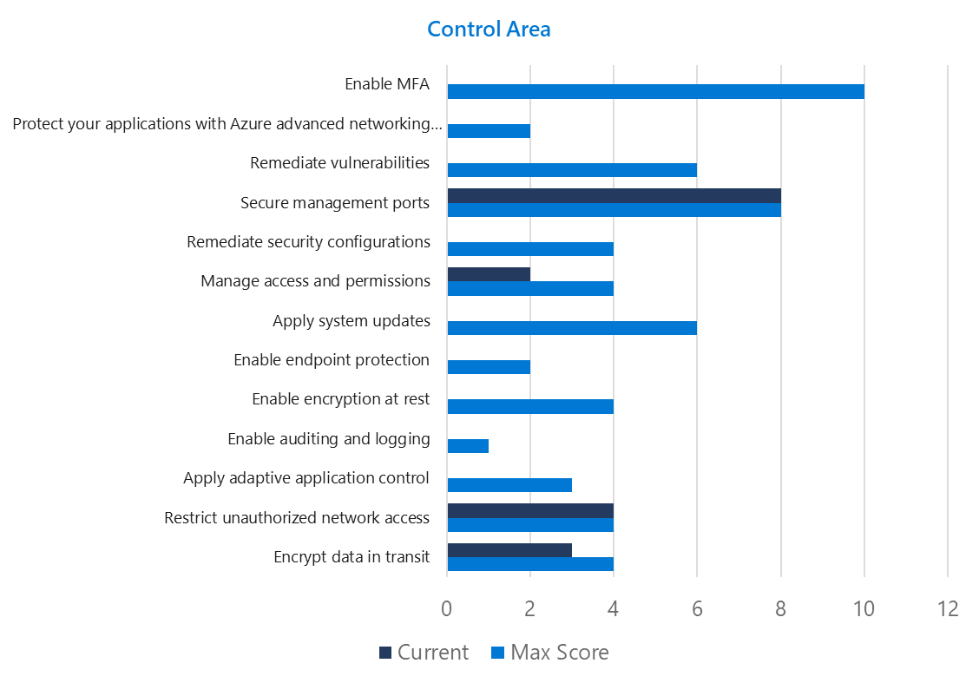
Security Azure Secure Scores
Your Current Azure Secure Score is 10 of out 52 possible points
Following Microsoft Secure Scores can help in implementing best practices
There are 15 risks left unaddressed
Implementing the Top 5 actions could increase your score by up to 27 points
The Azure Secure Score will also allow you to gain visibility across your environment to verify compliance with regulatory requirements, such as CIS, PCI DSS, SOC, and ISO
To learn more about your unique Azure Secure Scores, log in to your Azure portal here.

Slide 6
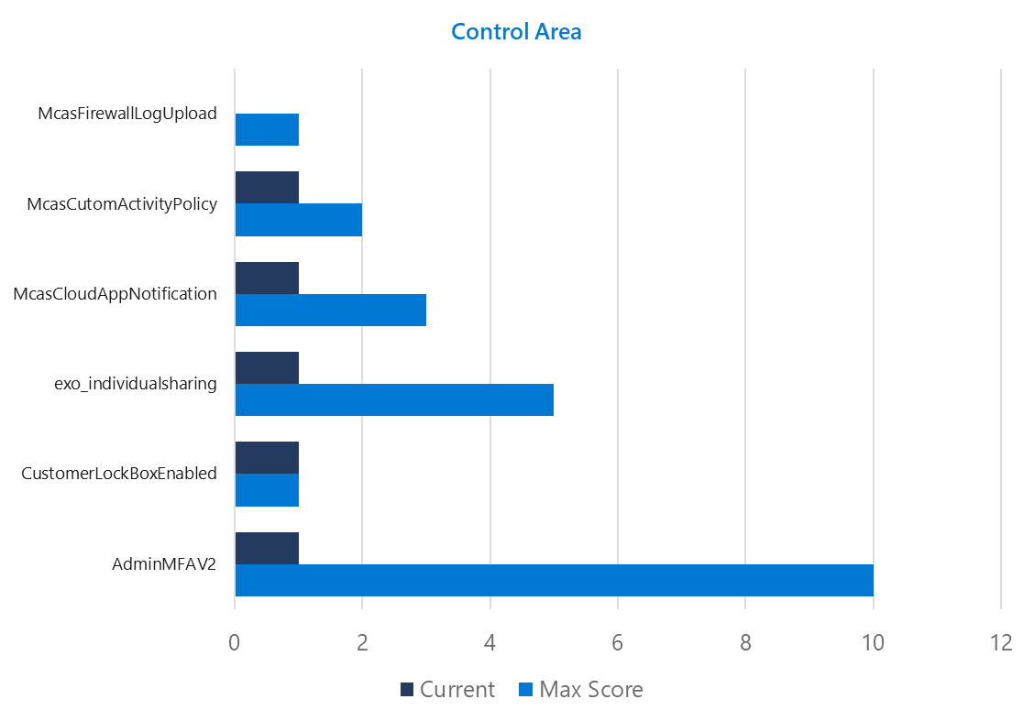
Security M365 Secure Scores
Your Current Microsoft 365 Secure Score is 53 of out 129 possible points
Following Microsoft Secure Scores can help in implementing best practices
There are 18 risks left unaddressed
Implementing the Top 5 actions could increase your score by up to 27 points
The Microsoft Secure Score will also allow you to gain visibility across your environment to verify compliance with regulatory requirements, such as CIS, PCI DSS, SOC, and ISO
To learn more about your unique M365 Secure Scores, log into your M365 portal here.

Slide 7
Security
Groups and Access
There were 7 top level sites found in your SharePoint, and 16 user departments had access to these sites.
Review the groups with access to each site to ensure accuracy of access levels.
SharePoint Sites |  | User Groups with Access
Sales |  | Business Development, Sales, Sales Managers
Finance |  | Management, Controllers, Legal Team, Kiosk Staff
IT |  | Sysadmins, Help Desk, Networking
Marketing |  | Management, Marketing, Sysadmins
Legal |  | Legal Team, Management, Help Desk, Maintenance
Operations |  | Consultants, Project Managers, Legal Team
HR |  | Human Resources, Management

Slide 8
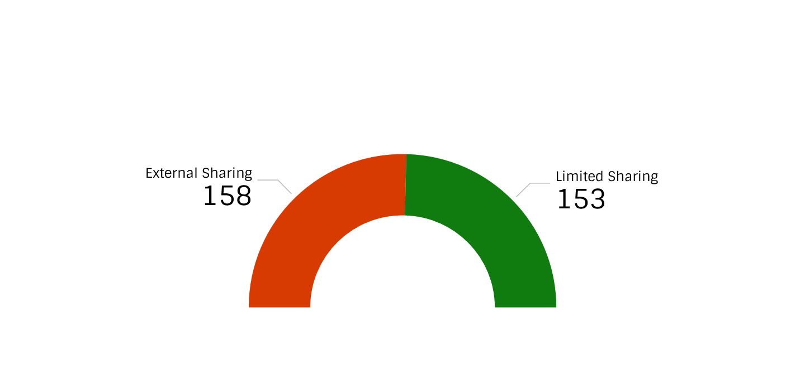
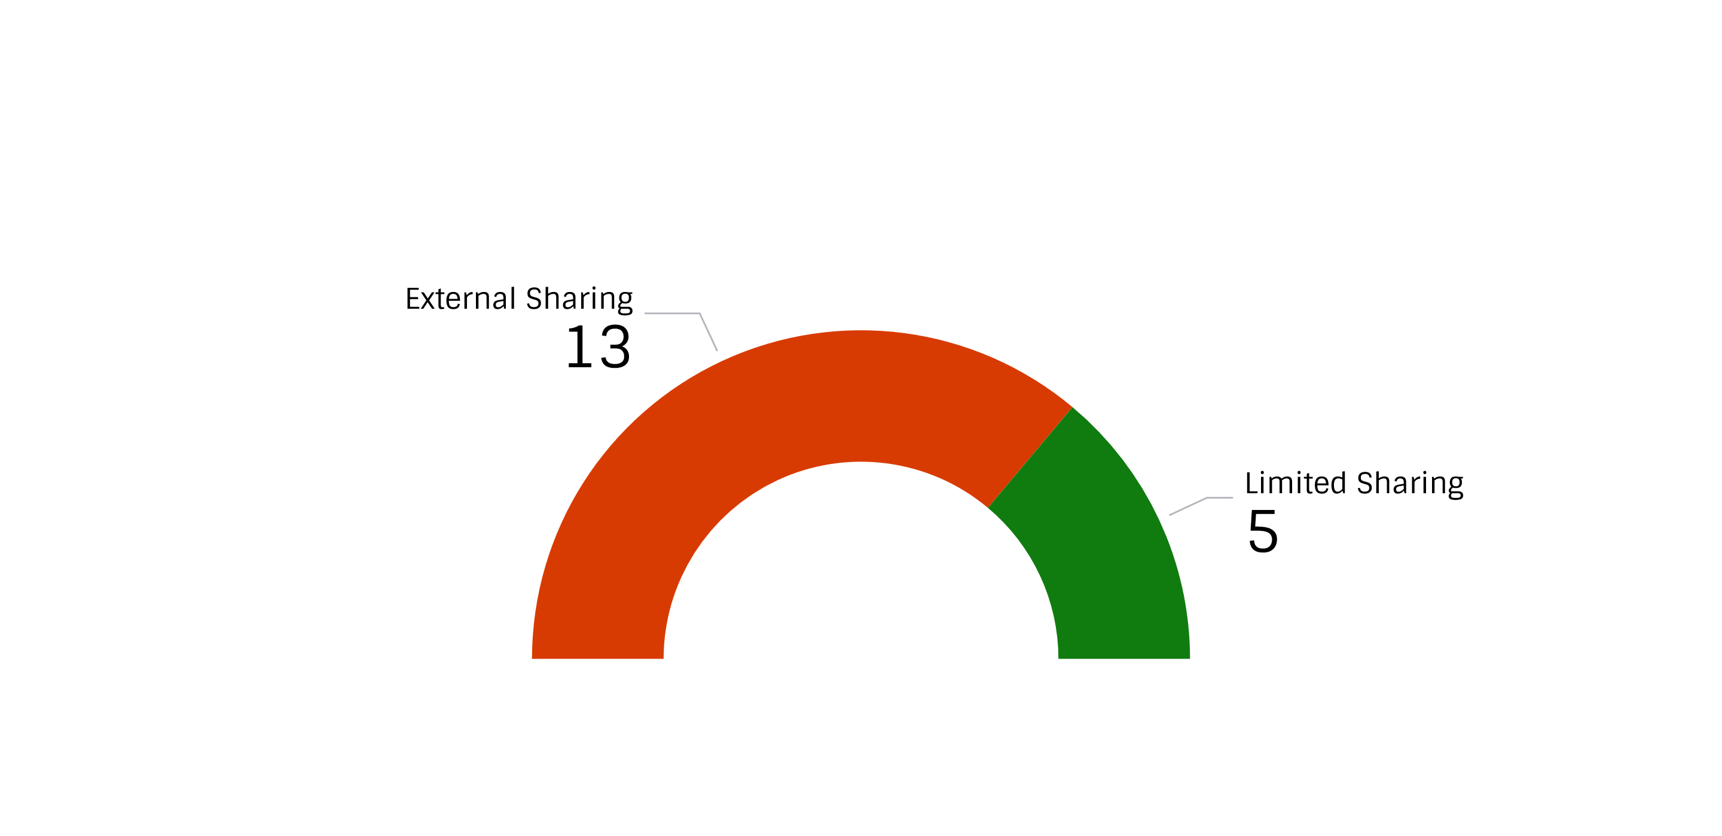
Security
External Sharing and External User
OneDrive Accounts
In SharePoint, external sharing was enabled for 13 of your 18 sites.
In OneDrive, external sharing was enabled for 158 of your 311 users.
External Users:
7 users were found who can access company resources with a different domain that require extra attention.
SharePoint Sites

Slide 9
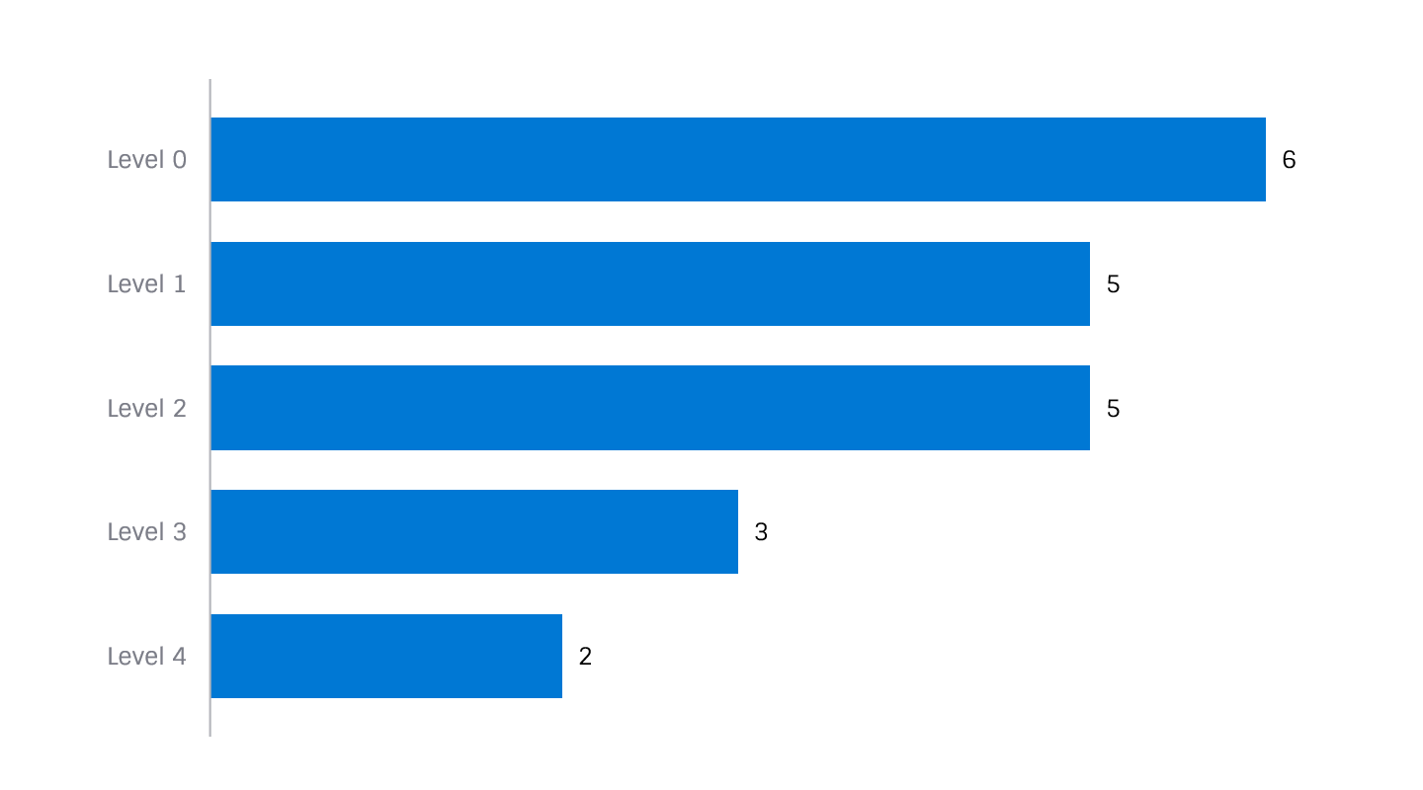
Security
Sensitivity Labels
We scanned your OneDrive and SharePoint environments for sensitivity labels
115 Files were found with assigned sensitivity labels
7 Different levels of sensitivity labels were found in use
Consider widespread adoption of Sensitivity Labels to ensure that data cannot be accessed by unauthorized users.

Slide 10
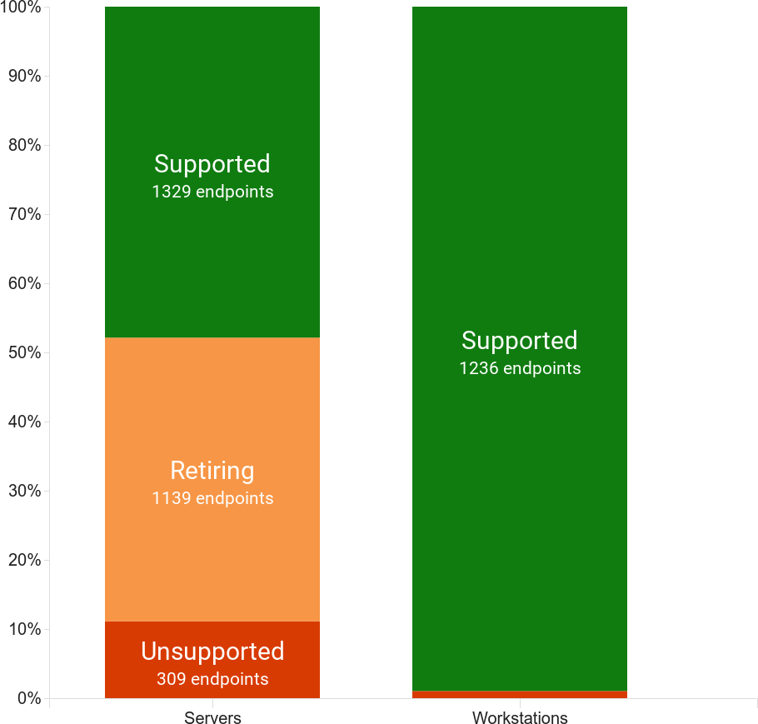
Security
Operating Systems
Out of 4,063 inventoried devices:
309 Servers were running an unsupported Operating System
50 Desktops were running an unsupported Operating System
Microsoft 365 provides access to the most current desktop operating systems and could help keep your environment up to date.

Slide 11
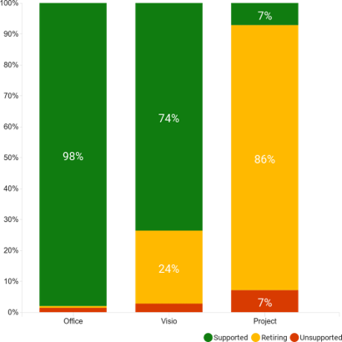
Security
Productivity Applications
Out of 4,063 inventoried devices:
2% of your Office installs were unsupported
2% of your Visio Installs were unsupported
7% of your Project installs were unsupported
Keeping productivity applications up to date not only minimizes attack surface but also ensures your users have access to the best features, such as Copilot.

Slide 12
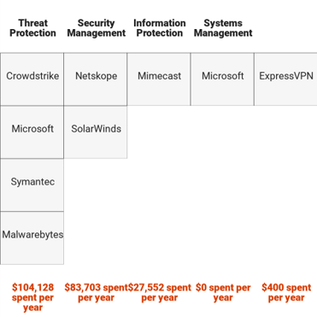
Security
Security Applications
Across your environment, we identified:
4 Threat Protection tools
2 Security Management tools
1 Information Protection tools
1 Systems Management tools
1 Identity Protection tools
Microsoft 365 E5 provides functionality across these 5 categories that could assist in consolidation.

Slide 13
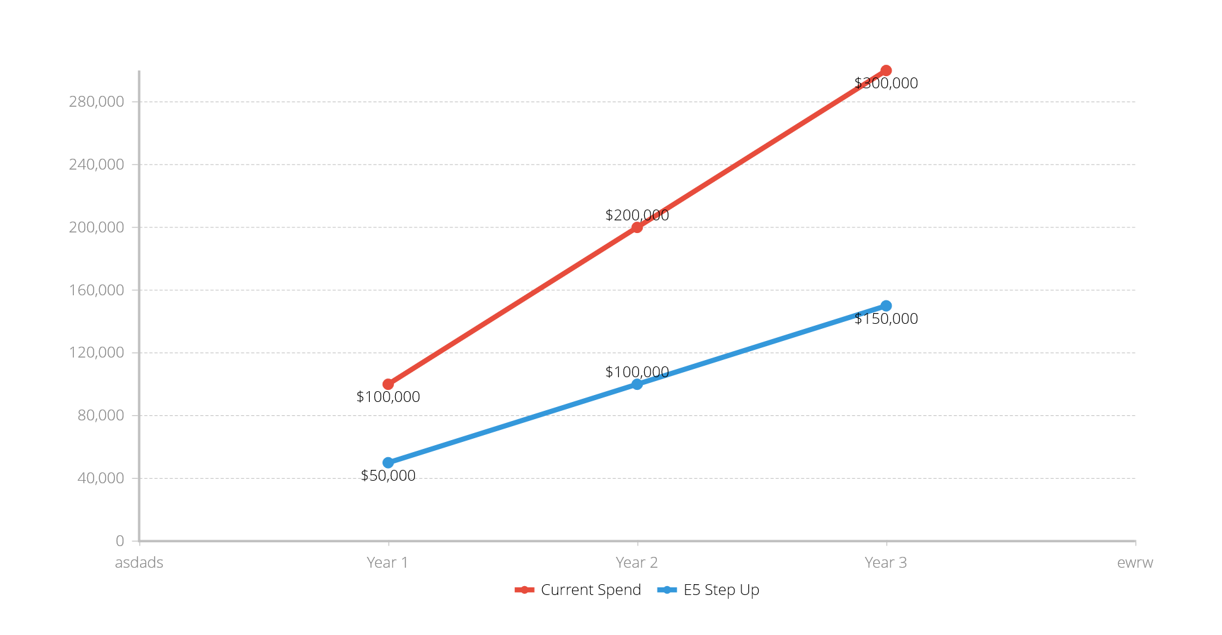
Security
Return on Investment
A Microsoft 365 E5 Step-Up could mean a $150,000 decrease in spending over 3 years.
Benefits of Microsoft E5 include:
Defender for Endpoint P2
Defender for Identity
Defender for Office P2
Endpoint DLP
RBAC
eDiscovery Premium
See Microsoft.com for a full list of additional E5 features

Slide 14
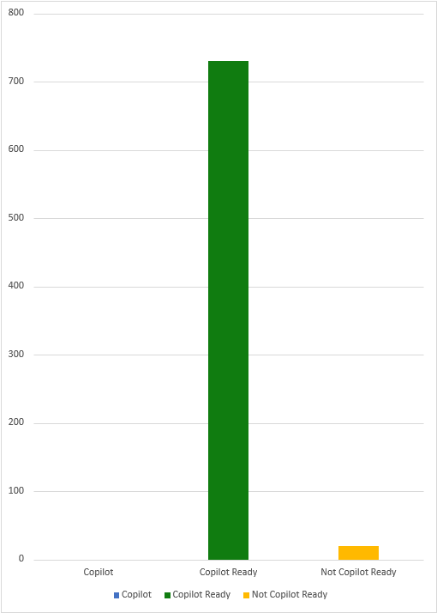
Licensing
How ready is your user base for Copilot licensing?
Today, 0 of your users are currently licensed for Copilot.
By holding a Business or Enterprise Microsoft 365 license, 730 of your users are eligible for Copilot at an incremental monthly cost.
To license the remaining 5 users for Copilot, they will first need to step up to a Copilot for Microsoft 365 compatible license.

Slide 15
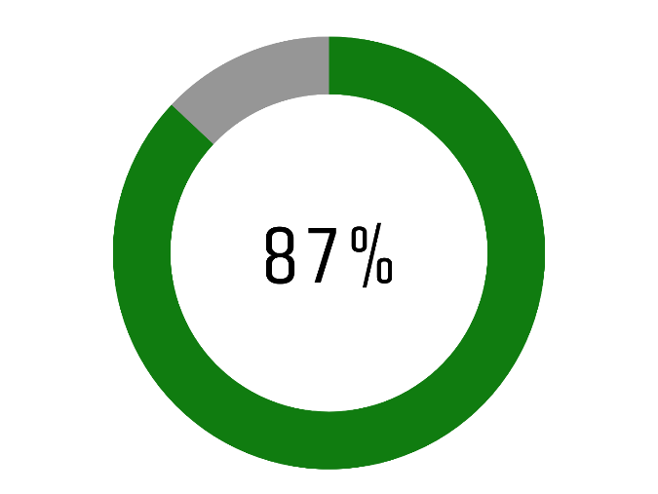
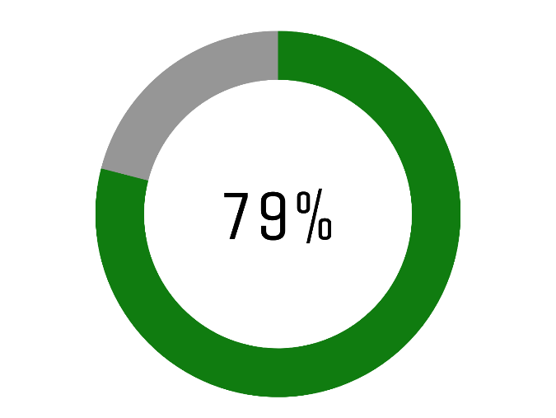
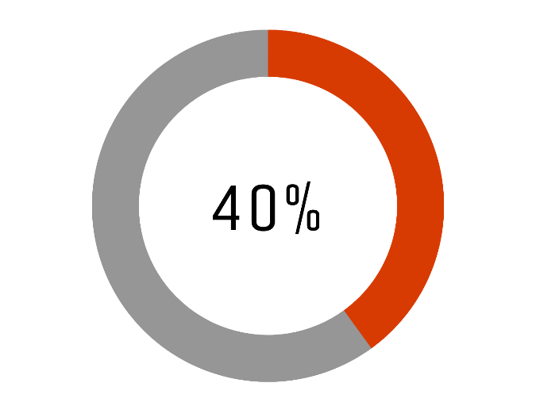
Optimization
Collaboration Tool Adoption
SharePoint Accounts
OneDrive Accounts
Teams Usage
To ensure optimal data uptake by Copilot once adopted, get a head start.
Encourage 38 additional users to adopt the use of SharePoint
Encourage 61 additional users to adopt the use of OneDrive
Encourage 175 additional users to adopt the use of Microsoft Teams
87%
79%
40%
254 users have active SharePoint accounts
231 OneDrive accounts were used in the last 30 days
117 Teams licenses were used in the last 30 days

Slide 16
Optimization
Productivity Tool Adoption
Word Usage
PowerPoint Usage
Excel Usage
87%
79%
40%
Evidence found in your environment suggests Copilot could offer time savings for your teams.
In the past 30 days:
254 users accessed Word
231 users accessed PowerPoint
117 users accessed Excel
231 users accessed OneNote
117 users accessed Outlook
Based on a Microsoft study, users experienced an average of 1.2 hours saved per week through Copilot use.
OneNote Usage
Outlook Usage
79%
40%

Slide 17
Recommendations
Environment
Users
Efficiency Gained
Considering current usage levels of Collaboration tools and Productivity Applications, we recommend licensing
112
users with Copilot.
A list of recommended users can be exported from the online portal.
By enabling 112 users with Copilot, your organization could save
6,720
employee work hours.
Based on Microsoft Study available here
Considering your scores in Security, Licensing, and Optimization, your organization has an overall Copilot readiness score of 44%

